Slide 1
DATA 602
convolutional neural networks

Slide 2
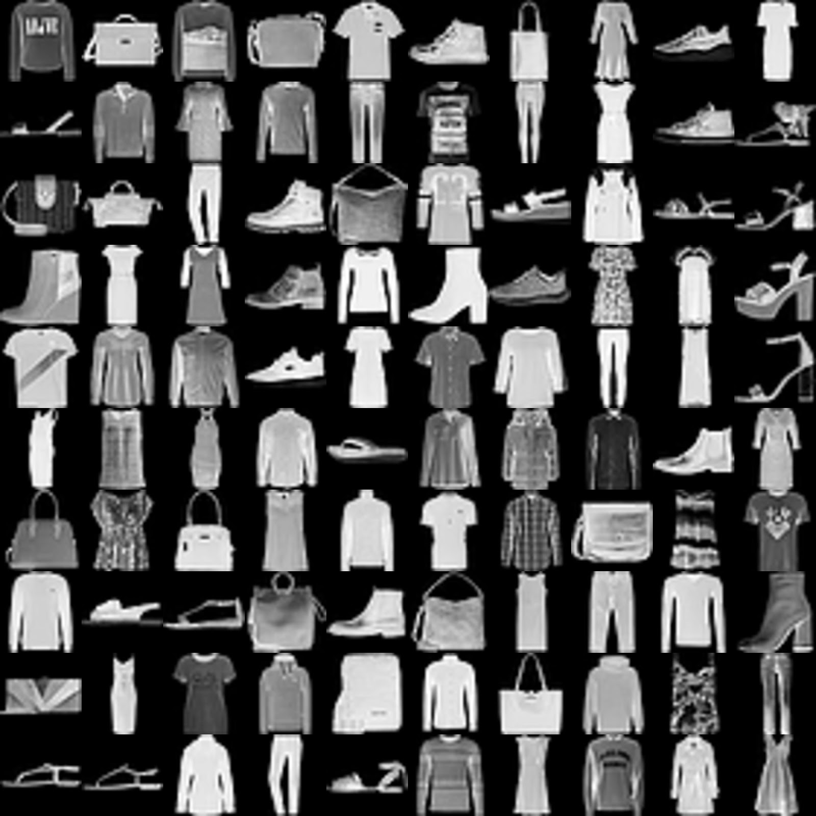
CNN
MNIST Fashion Data Set
70K images
10 categories
28x28 pixels
Can be used to train neural network

Slide 3
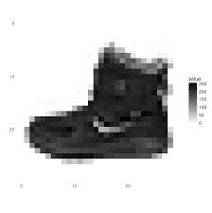
CNN
MNIST Data Set
70K images
10 categories
28x28 images
Can be used to train neural
network
https://github.com/zalandoresearch/fashion-mnist

Slide 4
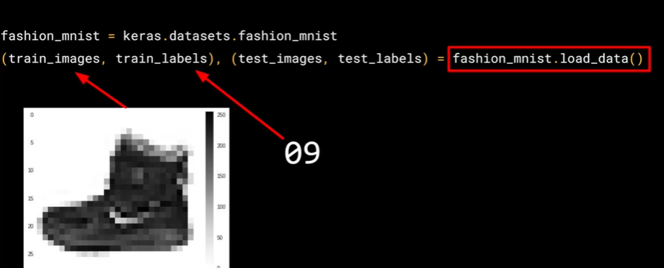
CNN

Slide 5
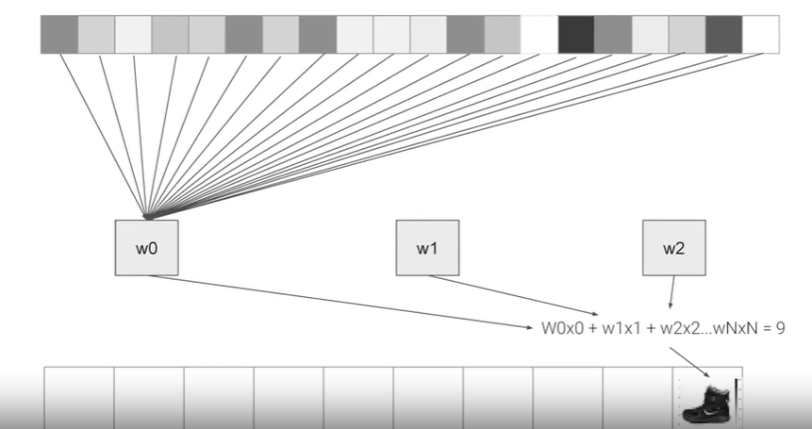
CNN

Slide 6
CNN- Optimization Algorithms
https://machinelearningmastery.com/adam-optimization-algorithm-for-deep-learning/
http://ruder.io/optimizing-gradient-descent/index.html

